Slide 1
THE BATTLE OF NEIGHBORHOODs
a machine learning approach to solving the problem associated with finding a suitable location for starting a business

Slide 2
Introduction
Problem Statement:
My client is looking for the best location to open a restaurant in the beautiful and peaceful city of Mississauga, Ontario, Canada. Due the different types of buildings and amenities in the different neighborhoods within the city, my client wants to get a favorable location that will be best suited for his restaurant business. In getting this suitable location, I will be considering the amenities within different neighborhoods and places where competitors are located within such neighborhood. This is aimed at maximizing profit for my client

Slide 3
Introduction (cont’d)
Background:
Before now, my client has opened 4 different restaurants at different locations within Mississauga but realized he has always either been outsmarted by bigger competitors or opened a restaurant in at a location that does not attract customers. He then approached me to see if there is a way I can use some machine learning algorithm that can help him in making informed decision as to the best location to open his next restaurant.

Slide 4
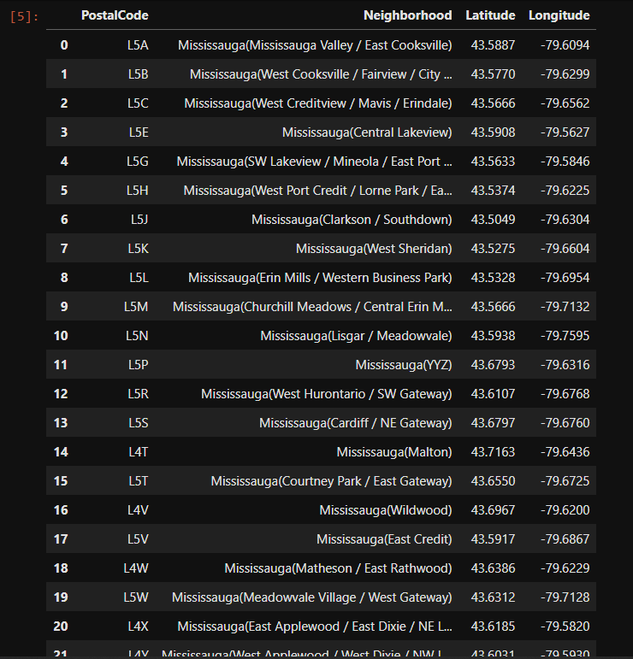
data
I will be fetching my data by using BeautifulSoup to scrape the Wikipedia page for Canada’s postal codes and their neighborhoods: (https://en.wikipedia.org/wiki/List_of_postal_codes_of_Canada:_L). With the postal codes for each neighborhood in Mississauga, I will then use Tableau to fetch the latitude and longitude of these postal codes.
The next step will be to use Foursquare to explore the venues in Mississauga and cluster the neighborhoods based on the categories of these venues using an unsupervised machine learning algorithm known as k-means. From these clusters I will be able to tell my client which neighborhoods will be best suited to open his next restaurant where he can attract more customers and perform better than his competitors. This will eventually lead to maximized profit.

Slide 5
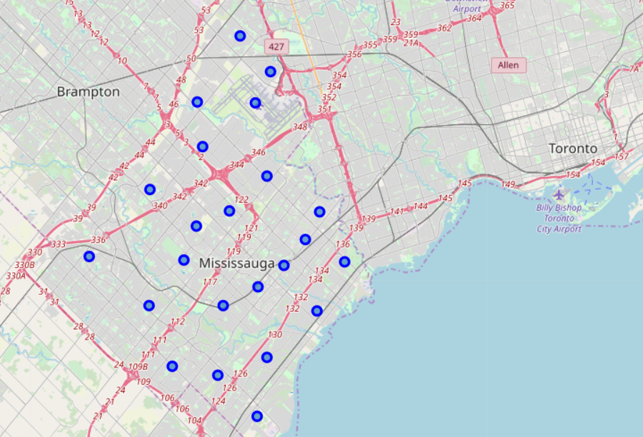
methodology
After importing the necessary python libraries for this project, I scraped the Wikipedia page of Canada postal codes using Beautful Soup. From this I was able to fetch the different neighborhoods in the city of Mississauga, Ontario together with their postal codes and place them in pandas dataframe.
Using these postal codes, I exported the dataframe and imported the file into Tableau so as to fetch the coordinates (latitude & longitude) of these postal codes.
Using the coordinates of Mississauga as whole (43.590338, -79.645729) I then used Foursquare API to explore venues in Mississauga.

Slide 6
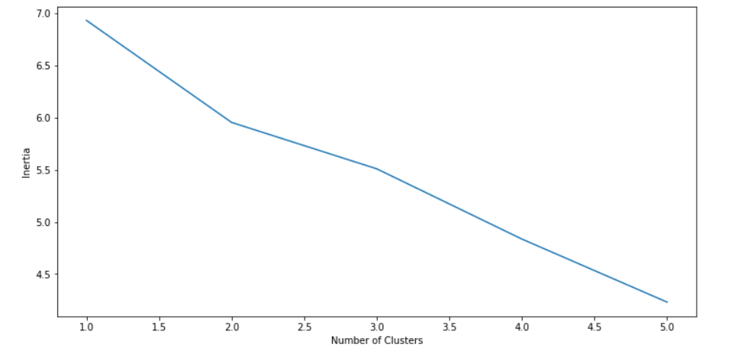
Methodology (cont’d)
I created a function called getnearbyvenues() and used this function to get all venues (amenities) within each neighborhood. I was able to group the neighborhoods based on the average number of different amenities within each neighborhood. With this I was able to see the popular venues within each neighborhood.
I then used an unsupervised machine learning algorithm known as KMeans to cluster these neighborhoods. I used elbow method to know the appropriate number of clusters to group the neighborhoods.

Slide 7
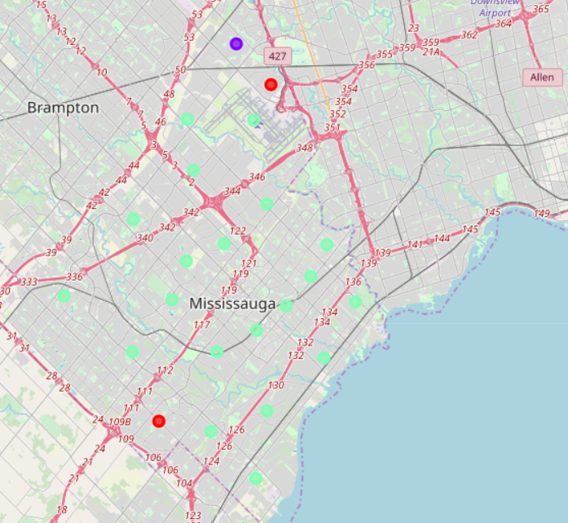
RESULTS
I successfully grouped the neighborhoods into 3 clusters
Cluster I:
Mississauga(Erin Mills / Western Business Park)
Mississauga(Wildwood)
Cluster II:
Mississauga(Malton)
Cluster III:
Mississauga(Mississauga Valley / East Cooksville)
Mississauga(West Cooksville / Fairview / City Centre
Mississauga(West Creditview / Mavis / Erindale)
Mississauga(Central Lakeview)
Mississauga(SW Lakeview / Mineola / East Port
Mississauga(West Port Credit / Lorne Park
Mississauga(Clarkson / Southdown)

Slide 8
Discussion & conclusion
From the above clusters, the k-means machine learning algorithm was able to tell where next my client should open his restaurant.
The best suitable neighborhood for my client to open his next restaurant could be in any of the neighborhoods in cluster 1: Mississauga(Erin Mills / Western Business Park) or Mississauga(Wildwood).
In terms of the 10 most popular amenities in these neighborhoods, Mississauga(Erin Mills / Western Business Park) do not have any restaurant as part of its top 10 amenities but has parks, gas station, comedy clubs, etc as part of the popular amenities around. This will be a perfect neighborhood for my client to open a restaurant as it will not only be proactive of him and give him the edge above his competitors, he will also be attracting customers who patronize other amenities around, thereby yielding potential huge profit in the long run.

